Slide 1
FAKE JOB DETECTION
ARDHRA P R
S3-A

Slide 2
RELEVANCE OF TOPIC
The number of fake job recruitment has increased during the COVID-19 pandemics due to the rise of the unemployment rates. In recent days, many companies prefer to post their vacancies online so that these can be accessed easily by the candidates. However, this intention may be one type of scam by the fraud people because they offer employment to job-seekers in terms of taking money from them. There are a lot of job advertisements on the internet, even reputed job advertising sites, which never seem fake. But after the selection, the recruiters start asking for the money and the bank details. Many of the candidates fall in the their trap and lose a lot of money and current job sometimes. Certain fraudulent job advertisements against a reputed company can be posted to lose their credibility. So, it is better to identify whether a job advertisement posted on the site is real or fake.

Slide 3
DESCRPTION OF THE PROJECT
Fake Job Detection is an automated tool using machine learning to detect fraud post for jobs in the internet. The fake job detection technique focuses on obtaining an automated tool for identifying fake jobs and helps people to avoid application for these jobs. Therefore, machine learning approach is applied which employs several classification algorithms for recognizing fake posts. In that case, a classification tool detects fake job posts from a larger number of job posts and makes aware of the user. Supervised learning algorithm as classification techniques are first considered to manage the problem of identifying scams on posting jobs. By considering the training data a classifier maps input variable to target classes. The classification models which can learn the job descriptions which are fraudulent can be created.

Slide 4
OBJECTIVES OF THE STUDY
We can apply machine learning to train a model for fake job classification. It can be trained on the previous real and fake job advertisements and it can identify a fake job accurately.
We will train the machine on fake job postings dataset to identify the fake job advertisement and then we use classification algorithm in this task which will predict the real and fraudulent class labels for the job advertisements after successful training.
We will evaluate the performance of our classifier using several evaluation metrics.

Slide 5
EXISTING SYSTEM AND PROPOSED SYSTEM
Existing System -Employment scam is one of the serious issues in recent times addressed in the domain of Online Recruitment Frauds (ORF). In recent days, many companies prefer to post their vacancies online so that these can be accessed easily and timely by the job-seekers. However, this intention may be one type of scam by the fraud people because they offer employment to job-seekers in terms of taking money from them. Fraudulent job advertisements can be posted against a reputed company for violating their credibility. These fraudulent job post detection draws a good attention for obtaining an automated tool for identifying fake jobs and reporting them to people for avoiding application for such jobs.

Slide 6
Proposed System -machine learning approach is applied which employs several classification algorithms for recognizing fake posts. In this case, a classification tool isolates fake job posts from a larger set of job advertisements and alerts the user. To address the problem of identifying scams on job posting, supervised learning algorithm as classification techniques are considered initially. A classifier maps input variable to target classes by considering training data. Classifiers addressed in the paper for identifying fake job posts from the others are described briefly. These classifiers based prediction may be broadly categorized into -Single Classifier based Prediction and Ensemble Classifiers based Prediction

Slide 7
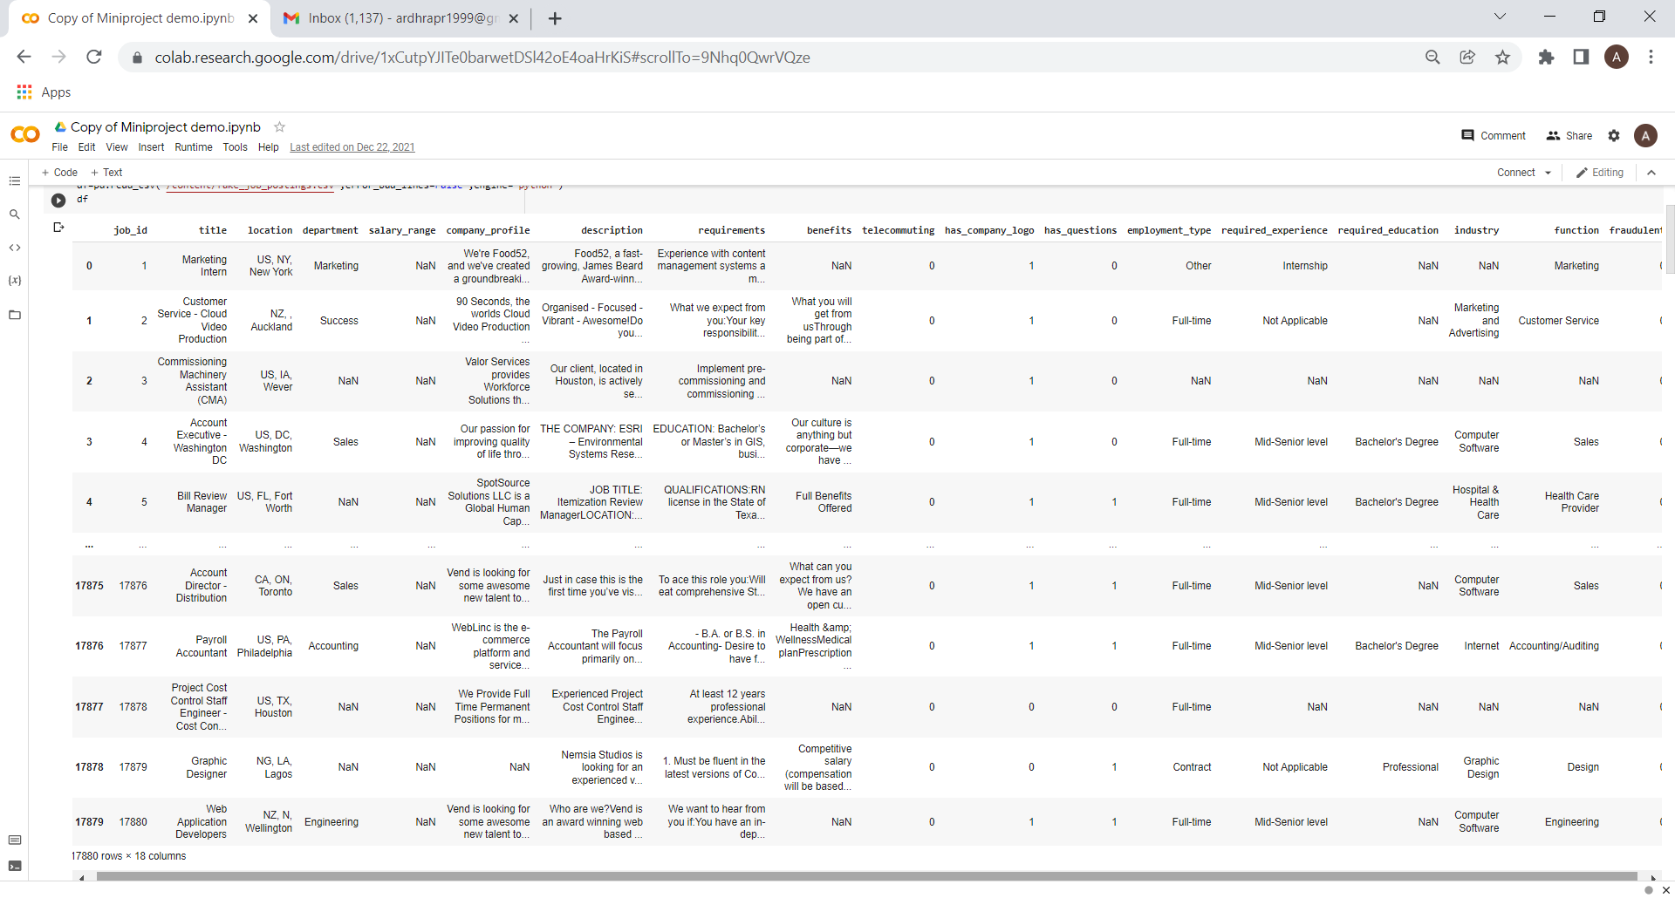

INPUT/OUTPUT AND MODULES IDENTIFIED
Training Dataset
Preprocessing
Feature Extraction
FAKE
Testing Dataset
Classification
REAL

Slide 8
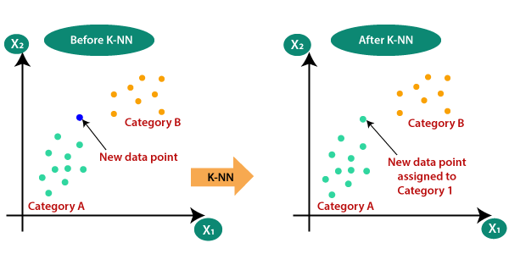
ALGORITHMS TO BE USED
1) K Nearest Neighbors Algorithm
K-Nearest Neighbour is one of the simplest Machine Learning algorithms based on Supervised Learning technique. K-NN algorithm stores all the available data and classifies a new data point based on the similarity. This means when new data appears then it can be easily classified into a well suite category by using K- NN algorithm.

Slide 9
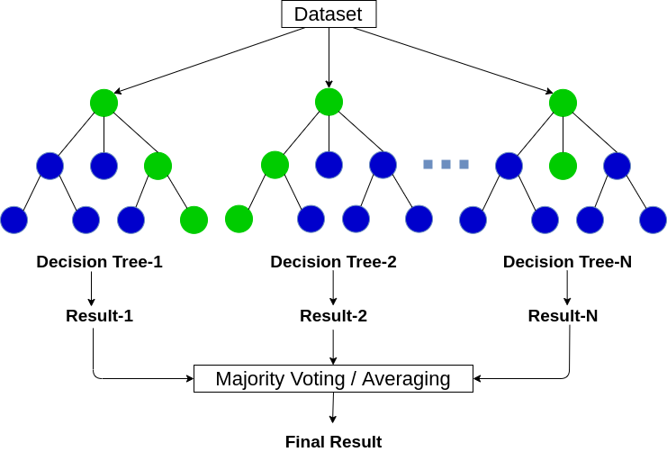
2) Random Forest Algorithm It is a supervised machine learning algorithm that creates decision trees on data samples and then gets the prediction from each of them and finally selects the best solution by means of voting.

Slide 10
DATASETS Dataset : 'fake_job_postings.csv’ (17880 rows &18 columns)

Slide 11





DETAILS OF BACK-END DESIGN, CODING
ENVIRONMENT AND TOOLS FOR THE PROJECT:
Language : Python
Libraries

Slide 12
Python: The language using to develop this project is python. The reason for choosing python is because it is currently the most popular programming language for machine learning. Python code is understandable by humans which makes it easier to build models for machine learning. The major libraries using include pandas, numpy, matplotlib, scikit learn and spacy. Pandas: stands for python data analysis library. Pandas can be used to import data and create a python object with rows and columns and can also be used to write data into a file. Using various commands pandas can be used for viewing, selecting, filtering and analyzing the data as well. Numpy: consists of multi dimensional array as well as matrix data structure. It can be used to perform fourier transformation and mathematical operations on arrays such as statistical and algebraic operations. Matplotlib: is an amazing visualization library. It can be used to create interactive graphs, charts and maps. Scikit learn: is very beneficial library as it provides with large number of useful tools which makes implementing machine learning in python a lot easier. It provides the ability to use many supervised and unsupervised algorithms just by importing those algorithms using the library. Spacy: is an open source software library for advanced natural language processing written in programming languages like python and cyton

Slide 13
THANK YOU

